Slide 1
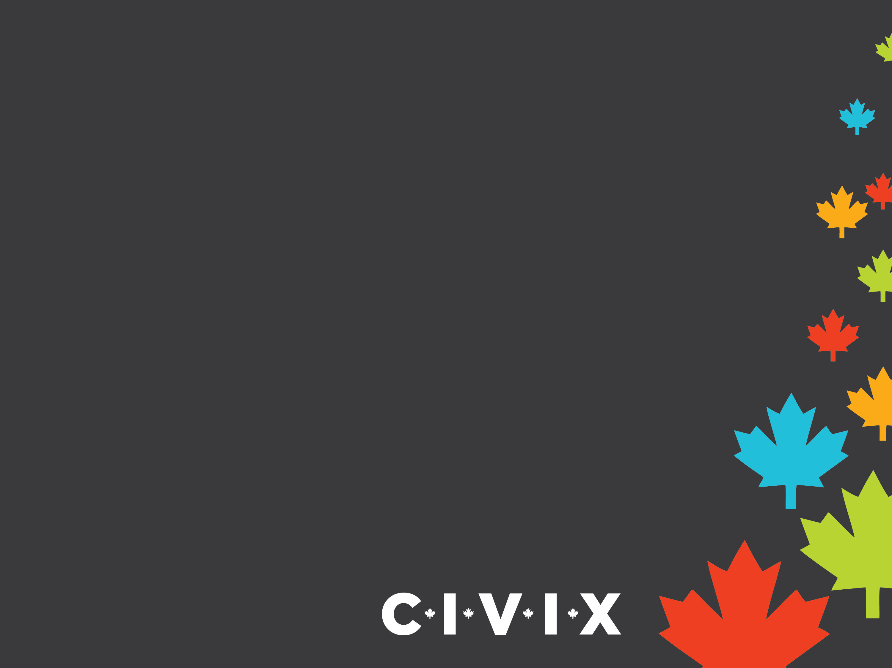
PowerPoint 3:
Government in Canada

Slide 2

Governments in Canada
Canada is a federal state, parliamentary democracy and constitutional monarchy.
A federal state brings together a number of different political communities with a central government (federal) for national matters and separate local governments (provincial/territorial) for local affairs.
As a parliamentary democracy, we elect members to our parliament and legislatures across the country.
As a constitutional monarchy, Canada’s head of state is a hereditary sovereign (queen or king), who reigns in accordance with the Constitution.

Slide 3
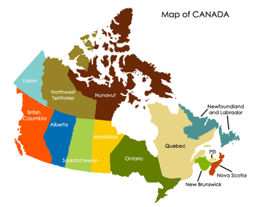
Three Levels of Government
Canada is a very large country with different needs and interests.
In order to meet the needs of citizens, the Canadian government is structured into a three-level system: federal, provincial/territorial and municipal/local.
Each level has its own arrangement of elected and appointed officials as well as a unique set of responsibilities.

